Slide 1

LOAN DEFAULT ANALYSIS
Presented by:
Saranya Selvaraj
Qualification:
B.Tech (CSE)
MS (AI & ML)
Pursuing
Experience:
6.5 Years

Slide 2
PROJECT INTRODUCTION
Objective : -
Analyze loan data to identify patterns and risk factors associated with loan defaults.
Methodology : -
Overview of data sources, analytical techniques (e.g., Chi-Square tests, T-tests, correlation analysis).
Data used : - https://drive.google.com/drive/folders/1WuUWyRA7uAjAl6OjMzbz2xp9CpDTBoi2?usp=drive_link

Slide 3
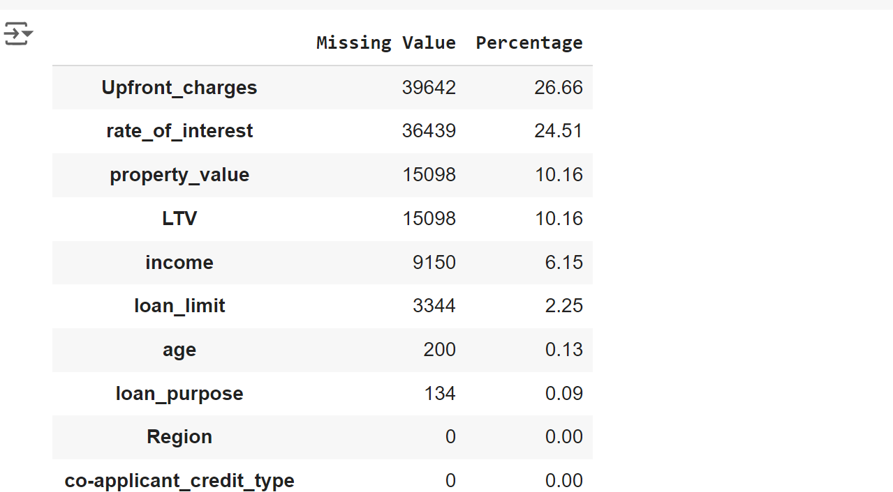
EXPLORING THE DATASET
There is 148670 rows and 20 columns
There is no duplicate rows.
All data is for the Year 2019
Instead of dropping all the null value rows, I have filled the null values with median values for numerical columns, mode values for categorical columns, LTV using the formula loan amount/ Property value*100.

Slide 4
DEMOGRAPHIC INSIGHTS
Gender: 18% of lenders are female; potential unequal access.
Age: 60% of borrowers are aged 35-64, indicating lower default risk.
Region: North and South regions show higher loan reliance compared to Central and North-East.

Slide 5
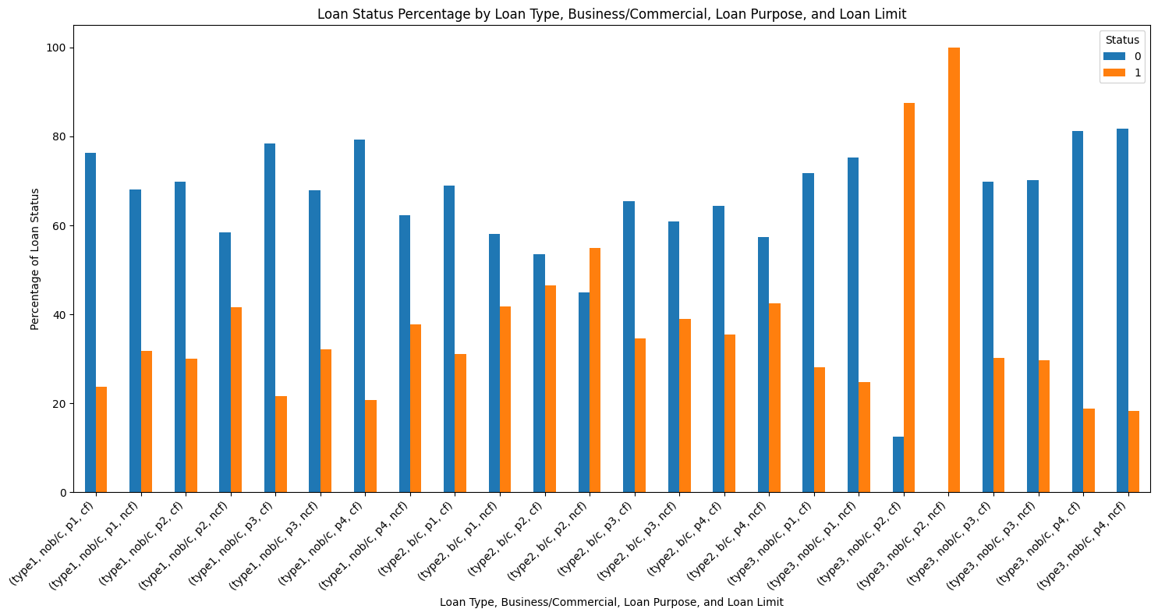
KEY OBSERVATIONS - LOAN CHARACTERISTICS
Loan Limit: 93% of loans are fixed, indicating a default lending approach.
Loan Type & Purpose: Loan Type 1 is the most common.
Loan purpose P3 and P4 are most frequent.
We can observe that (type2, b/c, p1, ncf) (type3, nob/c, p2, cf) (type1, nob/c, p4, ncf) (type2, b/c, p4, ncf) (type3, b/c, p2, cf) these combinations has the most defaulters percentage.

Slide 6
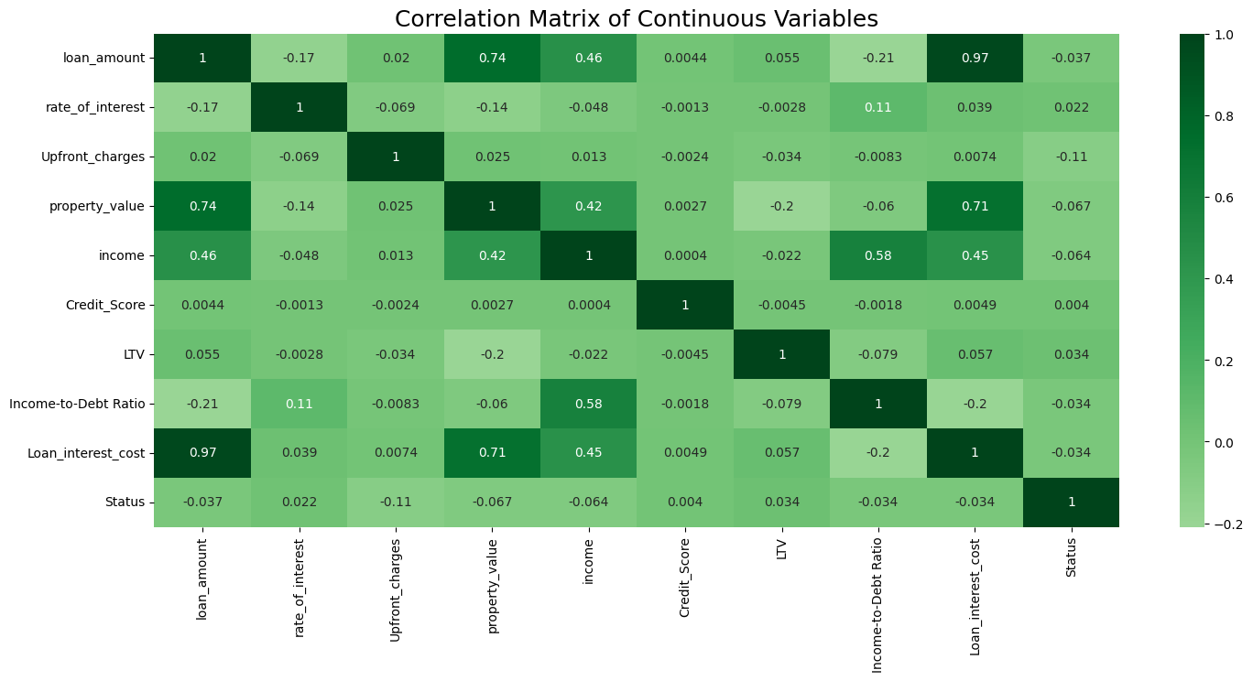
FINANCIAL INDICATORS
Occupancy: 92% of loans for primary residences; less risk of default.
Income-to-Debt Ratio: Low ratios correlate with higher defaults.

Slide 7
DEFAULT PATTERNS
Variable loan limit corelates to high default rates
Sex not available, followed by Male has high default rates
North East Region has high default rates
The highest defaults are observed in Type 2 loans, particularly for purposes P1 and P2.
A credit score of 500 corresponds to the highest default rates.
Low Income-to-Debt Ratios (0-20) correlate with higher default risk
Extreme skewness in income and LTV suggests significant outliers affecting the distribution.

Slide 8
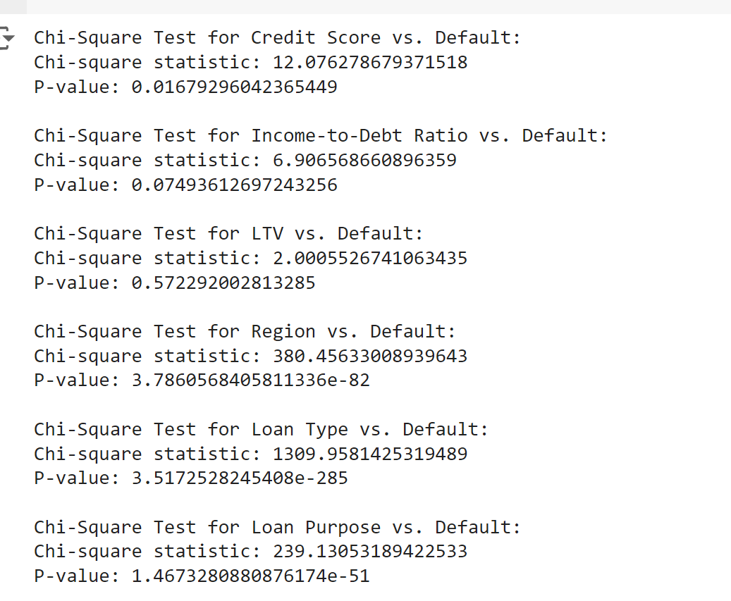
OBSERVATIONS FROM STATISTICAL TESTING TO FIND KEY FACTORS INFLUENCING DEFAULT RISK.
The tests reveal significant relationships between several factors and loan default.
Credit score, region, loan type, loan purpose, and gender all have strong associations with default rates, indicating these variables influence default risk. Income-to-debt ratio shows a potential relationship with default but is not statistically significant at the 0.05 level.
LTV has no significant association with default. Loan amounts and age also show statistically significant differences between defaulters and non-defaulters.
These findings highlight key factors influencing loan default risk.

Slide 9
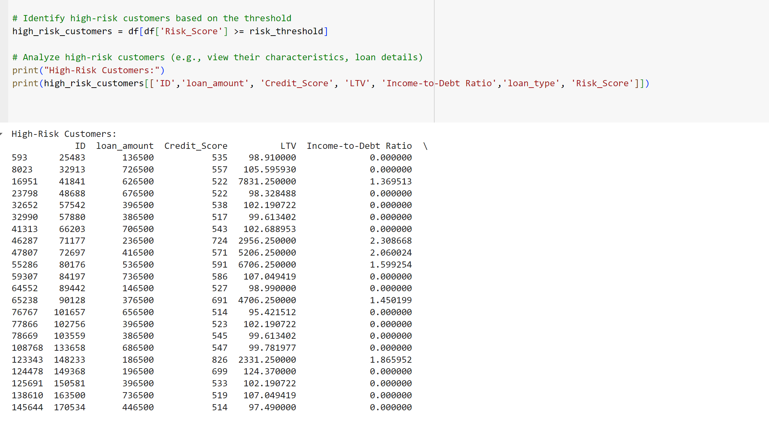
IDENTIFIYING LIST OF HIGH RISK CUSTOMERS FROM THE GIVEN DATASET

Slide 10
RECOMMENDATIONS FOR STAKEHOLDERS
Stricter Lending Criteria
Implement more rigorous credit assessments for high-risk categories (e.g., Type 2 loans).
Targeted Support
Develop support programs for at-risk borrowers, particularly in demographics with higher default rates.
Market Expansion
Explore lending opportunities in underrepresented regions (Central and North-East) to diversify risk.
Debt Management Guidance
Provide financial education to borrowers, focusing on maintaining healthy income-to-debt ratios.

Slide 11
RECOMMENDATIONS FOR STAKEHOLDERS
5.Monitor High-Risk Loans
Regularly assess loans with high LTV ratios and monitor default trends closely.
6.Data-Driven Insights
Utilize predictive analytics to identify potential defaulters early and adjust lending strategies accordingly.
7.Enhance Gender-Inclusive Practices
Create targeted campaigns to increase female borrowers' access to credit, addressing existing disparities.
8.Risk Mitigation Strategies
Establish a loan loss reserve fund to cushion against potential defaults, particularly in high-risk loan types.
By addressing these areas, the business can reduce the risk of loan defaults and improve overall lending performance.

Slide 12
CONCLUSION
- Comprehensive Data Analysis:
Conducted an in-depth analysis of the provided dataset to uncover patterns and factors contributing to loan defaults.
- Identification of High-Risk Customers:
Identified a list of high-risk customers with a greater likelihood of defaulting based on key financial indicators and behaviors.
- Risk Factors and Predictive Insights:
Highlighted the combinations of variables that significantly increase the probability of loan defaults, offering predictive insights for early detection.
- Preventive Recommendations:
Proposed actionable strategies to minimize default risks, including enhanced risk assessment and monitoring of vulnerable customers.
- Mitigation Measures:
Suggested appropriate steps to be taken in the event of defaulting, ensuring timely intervention to mitigate potential losses.

